Slide 1


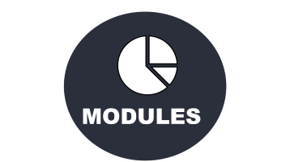
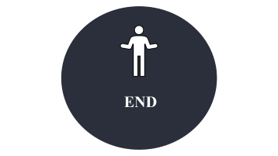

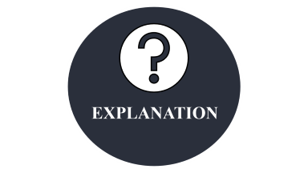




Slide 2

INTRODUCTION

Slide 3
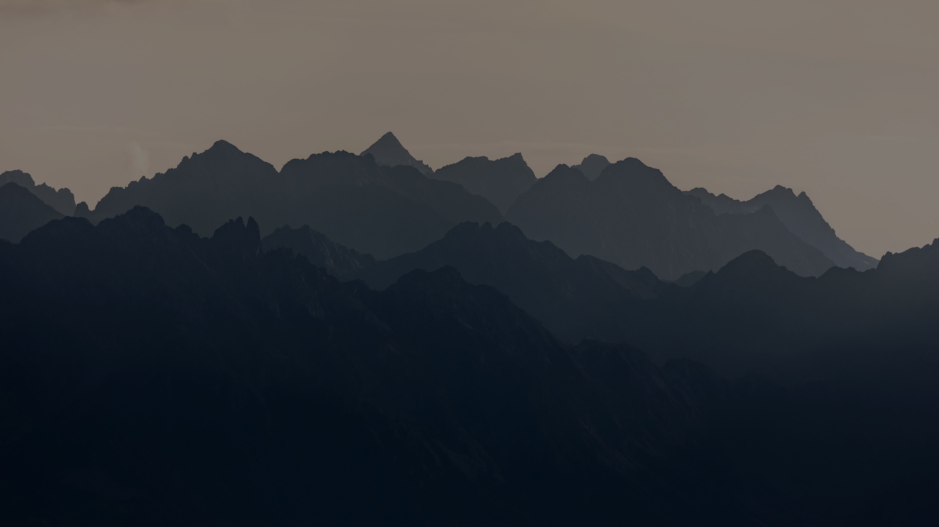


INTRODUCTION
Human body contain many types of cells with each cell having its separate function. Cells grow and divide in orderly manner to form new cells which is necessary to keep our body healthy. When cells lose their ability to grow and divide normally, an unordered and uncontrolled growth of cells take place which forms a mass of tissue called tumor. Brain tumor is a mass of tissue containing abnormal cells in the brain.
ABSTRACT

Slide 4
Although some tumors are not cancerous, detecting them in early stages is very important to start proper treatment. The traditional method to detect brain tumor includes a radiologist analyzing the MRI images to find abnormalities and make decisions.
MRI images also contain intensity problems which image processing can reduce to certain extent to which machines can easily see that a naked eye cannot. Different deep learning methods can be used in detecting tumors, CNN being one of the methods. CNN has variety of applications in facial recognition, analyzing images, classification, understanding climate and many more. CNN is commonly used in the field of image classification.
ABSTRACT

Slide 5
ABSTRACT

Slide 6

ABSTRACT
Brain tumor is the growth of abnormal cells in brain some of which may leads to cancer. The usual method to detect brain tumor is Magnetic Resonance Imaging (MRI) scans. From the MRI images information about the abnormal tissue growth in the brain is identified.
Brain tumor is a serious health condition which can be fatal if not treated on time. Hence it becomes necessary to detect the tumor in initial stages for planning treatment at the earliest. A CNN model for detection of brain tumor. Firstly brain MRI images are augmented to generate sufficient data for deep learning. The images are then pre-processed to remove noise and make images suitable for further steps. The proposed system is trained with pre-processed MRI brain images that classifies newly input image as tumorous or normal based on features extracted during training.
ABSTRACT

Slide 7

EXISTING

Slide 8
EXISTING
In existing system, brain cancer was detected using image processing techniques. Initially a brain CT scan image is acquired and the pre-processing techniques are applied on it. Then pre-processed image is segmented. In these systems, the techniques used in the detection of the brain cancer were confined to segmentation.
These approaches are also suffered from certain issues which can be removed by improving the technology used in it. Furthermore, all the work has done only for detecting whether it’s cancerous or not but none detected to which stage does the cancer belong.
ABSTRACT

Slide 9
Disadvantages:
Many systems are confined only to segmentation.
They suffer from certain technology issues.
Some of the systems work only on cancerous image.
Staging is not done.
Less accuracy.
ABSTRACT

Slide 10

PROPOSED

Slide 11
PROPOSED
CNNs are the most researched machine learning algorithms in medical image analysis. The reason for this is that CNNs preserve spatial relationships when filtering input images. As mentioned, spatial relationships are of crucial importance in radiology, for example, in how the edge of a bone joins with muscle, or where normal lung tissue interfaces with cancerous tissue.., a CNN takes an input image of raw pixels, and transforms it via Convolutional Layers, Rectified Linear Unit (RELU) Layers and Pooling Layers. This feeds into a final Fully Connected Layer which assigns class scores or probabilities, thus classifying the input into the class with the highest probability.
ABSTRACT

Slide 12
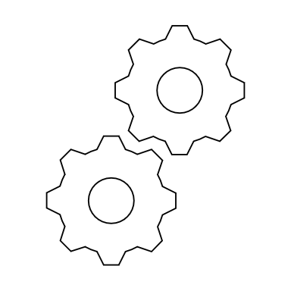
ARCHITECTURE

Slide 13
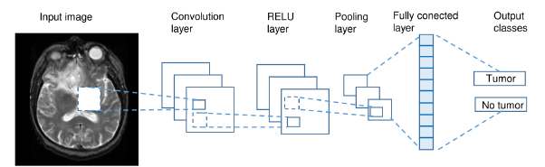
ARCHITECTURE
ABSTRACT

Slide 14
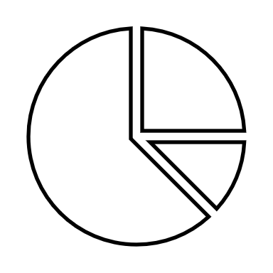
MODULES

Slide 15

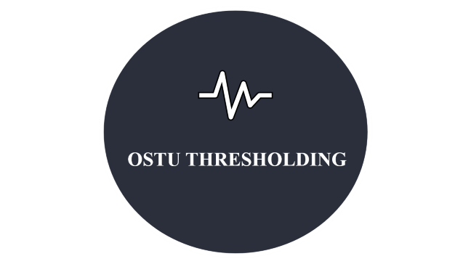


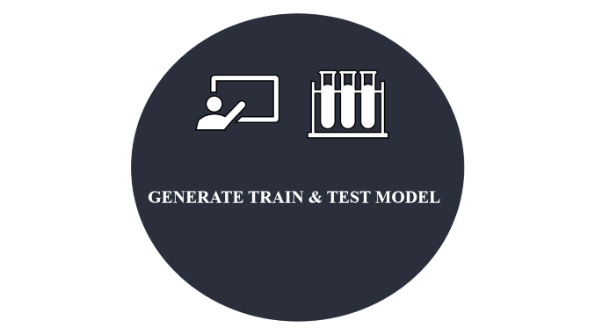


Slide 16

UPLOAD MRI IMAGE

Slide 17
Save the MRI image on your computer: If you have an MRI image file, save it to your computer so that you can upload it later. Make sure you know where the file is saved on your computer.
Choose an online platform to upload the MRI image: There are several online platforms available where you can upload and share your MRI images, such as Google Drive, Dropbox, or Microsoft OneDrive. Choose the platform that you are most comfortable using.
Sign up and log in: If you are not already signed up with the platform, you will need to create an account. Once you have signed up, log in to the platform.
Upload the MRI image: Once you have logged in to the platform, look for the "Upload" button and click on it. Choose the MRI image file that you saved on your computer and upload it to the platform. Make sure that the image is in a format that the platform can accept, such as JPEG or PNG
ABSTRACT

Slide 18

OSTU THRESHOLDING

Slide 19
Compute the histogram of the image to obtain the frequency distribution of pixel intensities.
Compute the normalized histogram by dividing each bin by the total number of pixels in the image.
Initialize the between-class variance to zero.
Iterate over all possible threshold values, and compute the corresponding between-class variance.
Determine the threshold value that maximizes the between-class variance.
Threshold the image using the optimal threshold value.
The output of the Otsu thresholding algorithm is a binary image, where the foreground pixels are assigned a value of 1 and the background pixels are assigned a value of 0. This binary image can then be used for further image processing tasks such as object detection, feature extraction, or image analysis.
ABSTRACT

Slide 20


GENERATE TRAIN & TEST MODEL

Slide 21
CNN ALGORITHM
Input image: The first step is to input an image into the CNN. The image is typically represented as a matrix of pixel values.
Convolution: The next step involves applying a series of convolutional filters to the image. Each filter extracts a particular feature from the image, such as edges, corners, or textures.
Activation: After each convolution operation, an activation function is applied to the output of the filter. This helps to introduce non-linearity into the model, which is important for learning complex patterns in the data.
Pooling: The output of the activation function is then downsampled using a pooling operation. This helps to reduce the dimensionality of the output and improve the computational efficiency of the model.
Fully connected layers: Once the image has been processed through the convolutional and pooling layers, the output is passed through one or more fully connected layers. These layers perform classification or regression tasks based on the features extracted from the image.
Output: Finally, the output of the fully connected layers is passed through a softmax activation function to produce a probability distribution over the possible classes or labels.
ABSTRACT

Slide 22
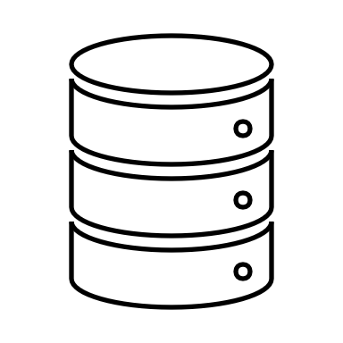
GET DRIVEHQ IMAGES

Slide 23
Log in to your DriveHQ account: Go to the DriveHQ website and log in to your account using your username and password.
Navigate to the folder containing the images: Once you have logged in, navigate to the folder where your images are stored. You can do this by clicking on the folder name or by using the folder tree navigation panel.
Select the images you want to download: To select multiple images, hold down the Ctrl key on your keyboard and click on each image. To select all images in the folder, press Ctrl+A on your keyboard.
Download the images: Once you have selected the images, click on the Download button in the DriveHQ interface. The images will be downloaded to your local computer in a compressed (zip) format.
Extract the images: After the download is complete, extract the images from the zip file using a file extraction software such as WinZip, WinRAR, or 7-Zip.
ABSTRACT

Slide 24

EXPLANATION

Slide 25

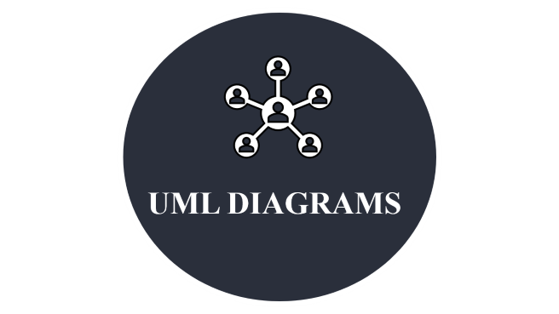

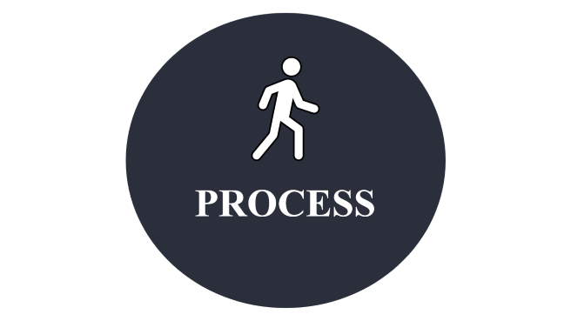


Slide 26

REQUIREMENTS

Slide 27
SOFTWARE REQUIREMENTS
OS : Windows
Python IDE : Python 3.7.0
HARDWARE REQUIREMENTS
RAM : 4GB and Higher
Processor : Intel i3 and above
Hard Disk : 500GB: Minimum
ABSTRACT

Slide 28
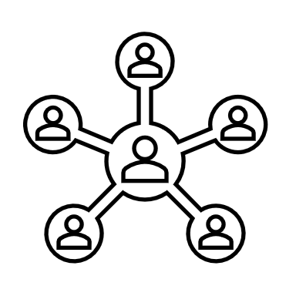
UML DIAGRAMS

Slide 29
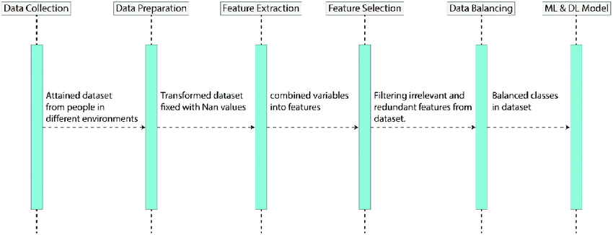
SEQUENCE DIAGRAM:
ABSTRACT

Slide 30
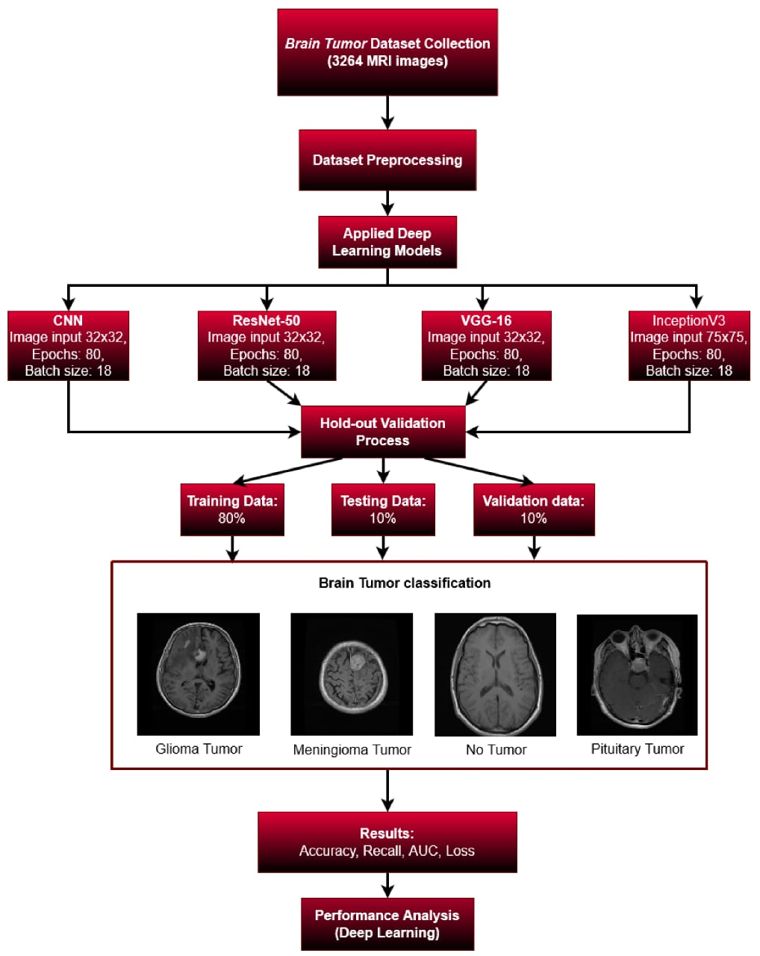
ACTIVITY DIAGRAM:
ABSTRACT

Slide 31

PROCESS

Slide 32
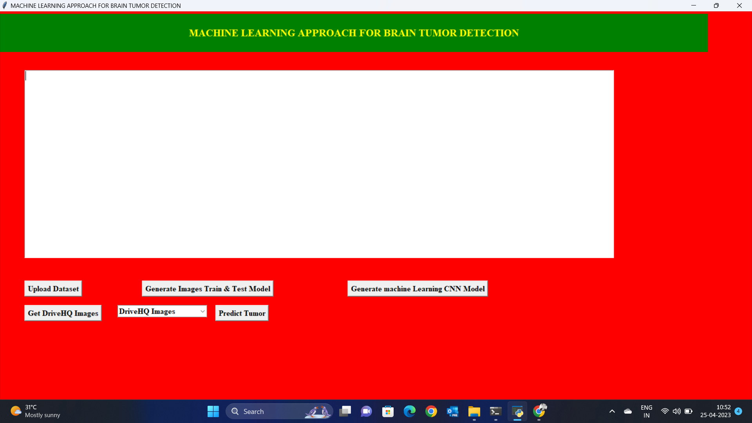
Home Page
ABSTRACT

Slide 33
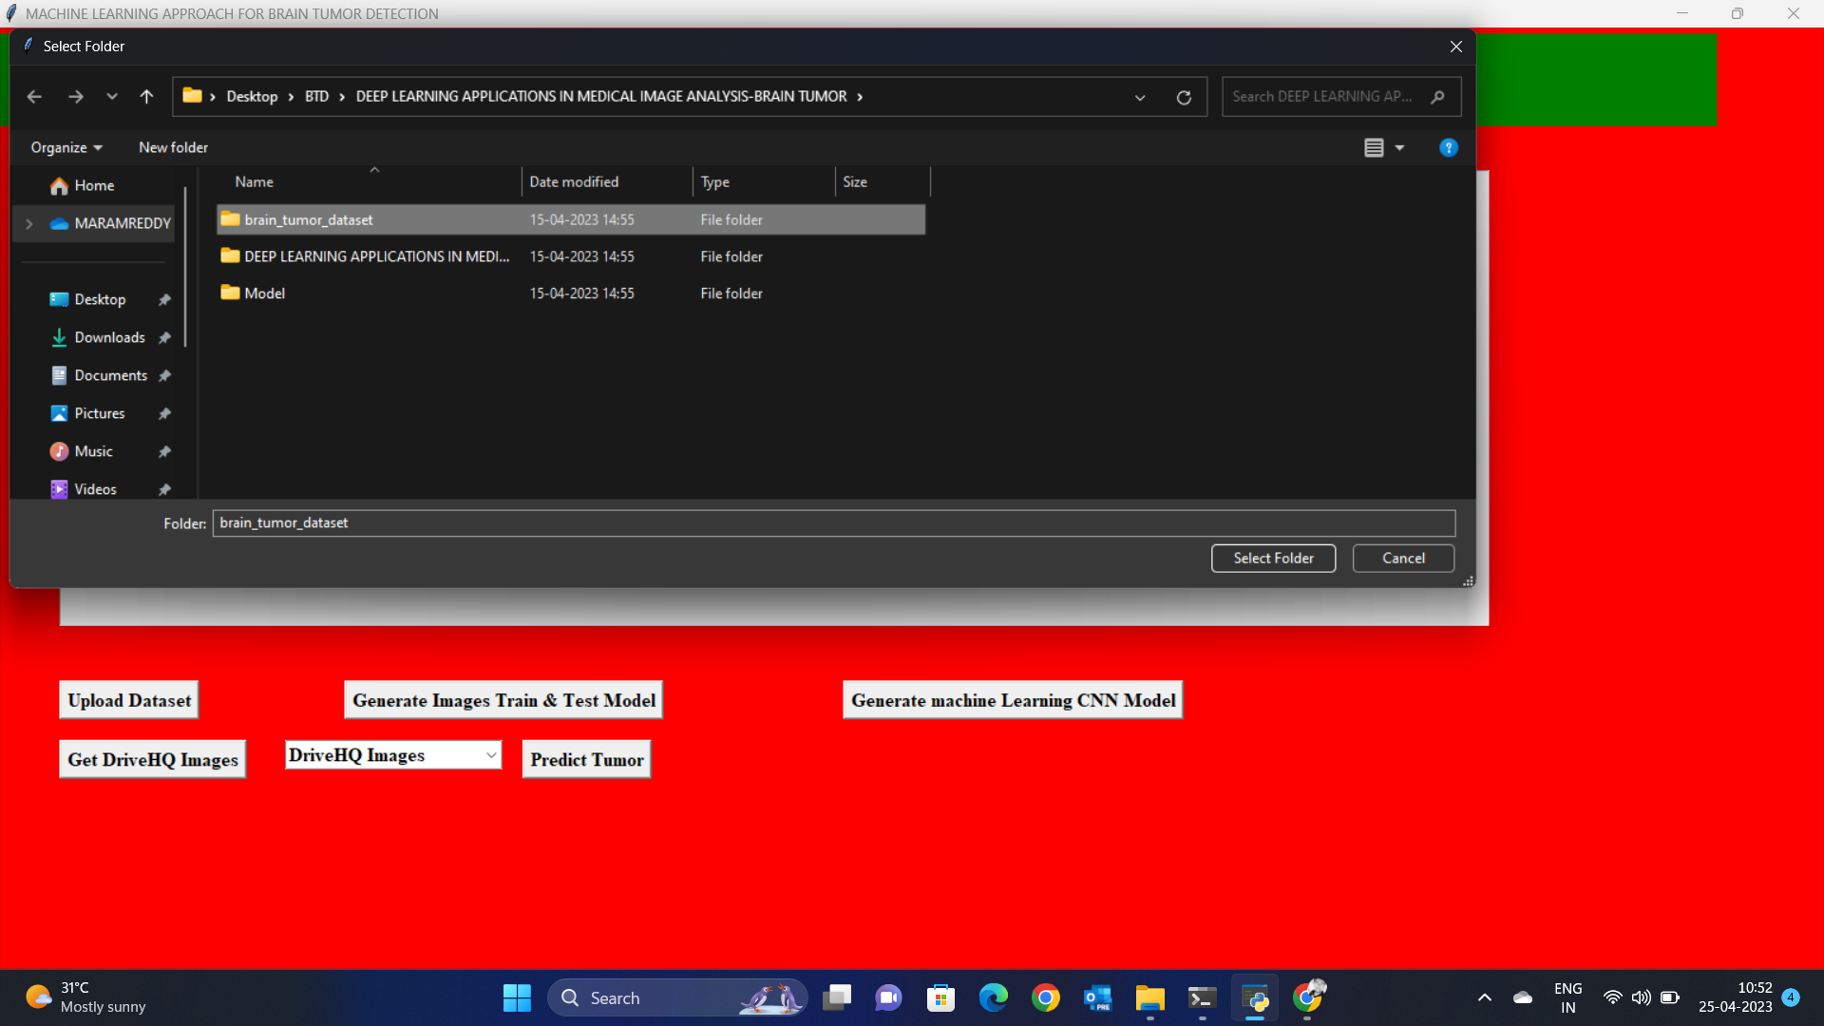
Upload Dataset
ABSTRACT

Slide 34
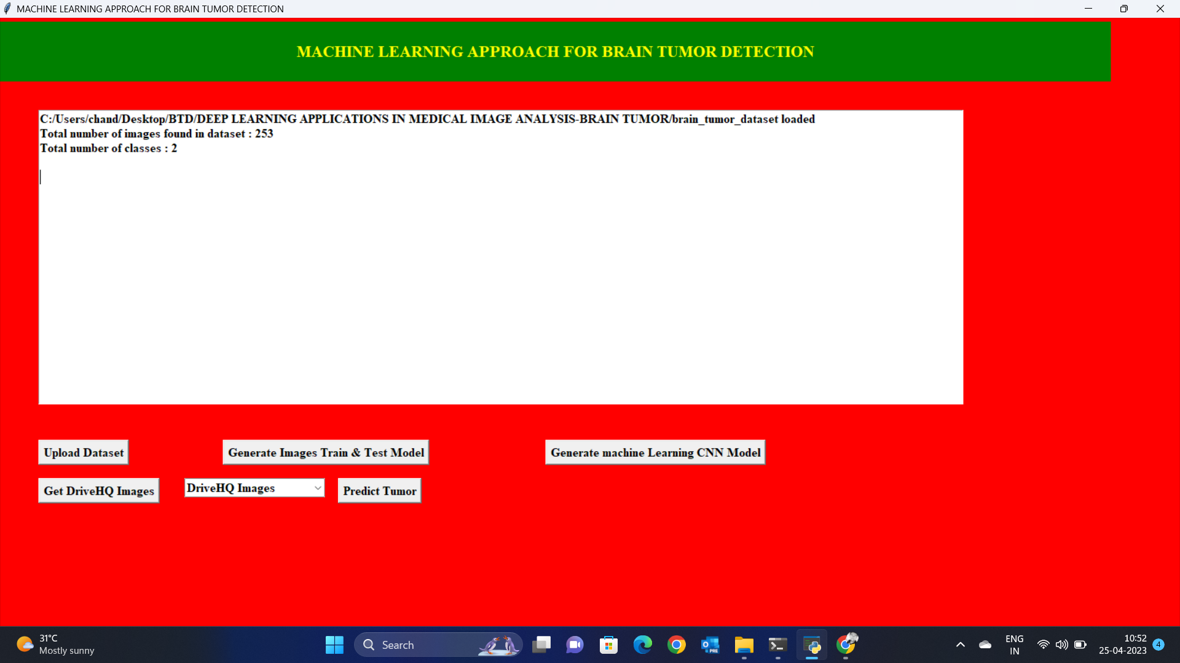
Generate Train and Test Model
ABSTRACT

Slide 35
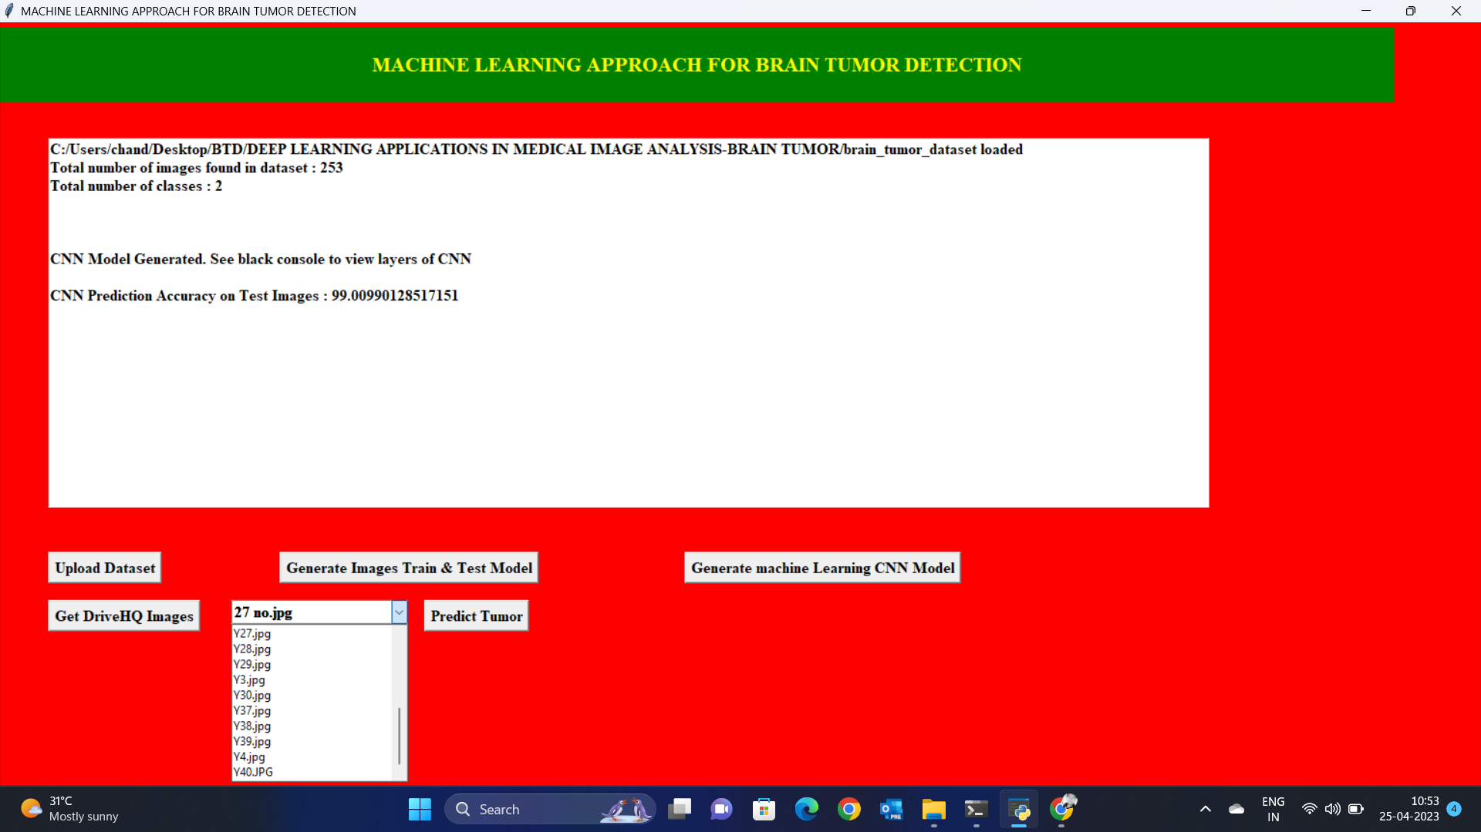
Run Algorithm
ABSTRACT

Slide 36
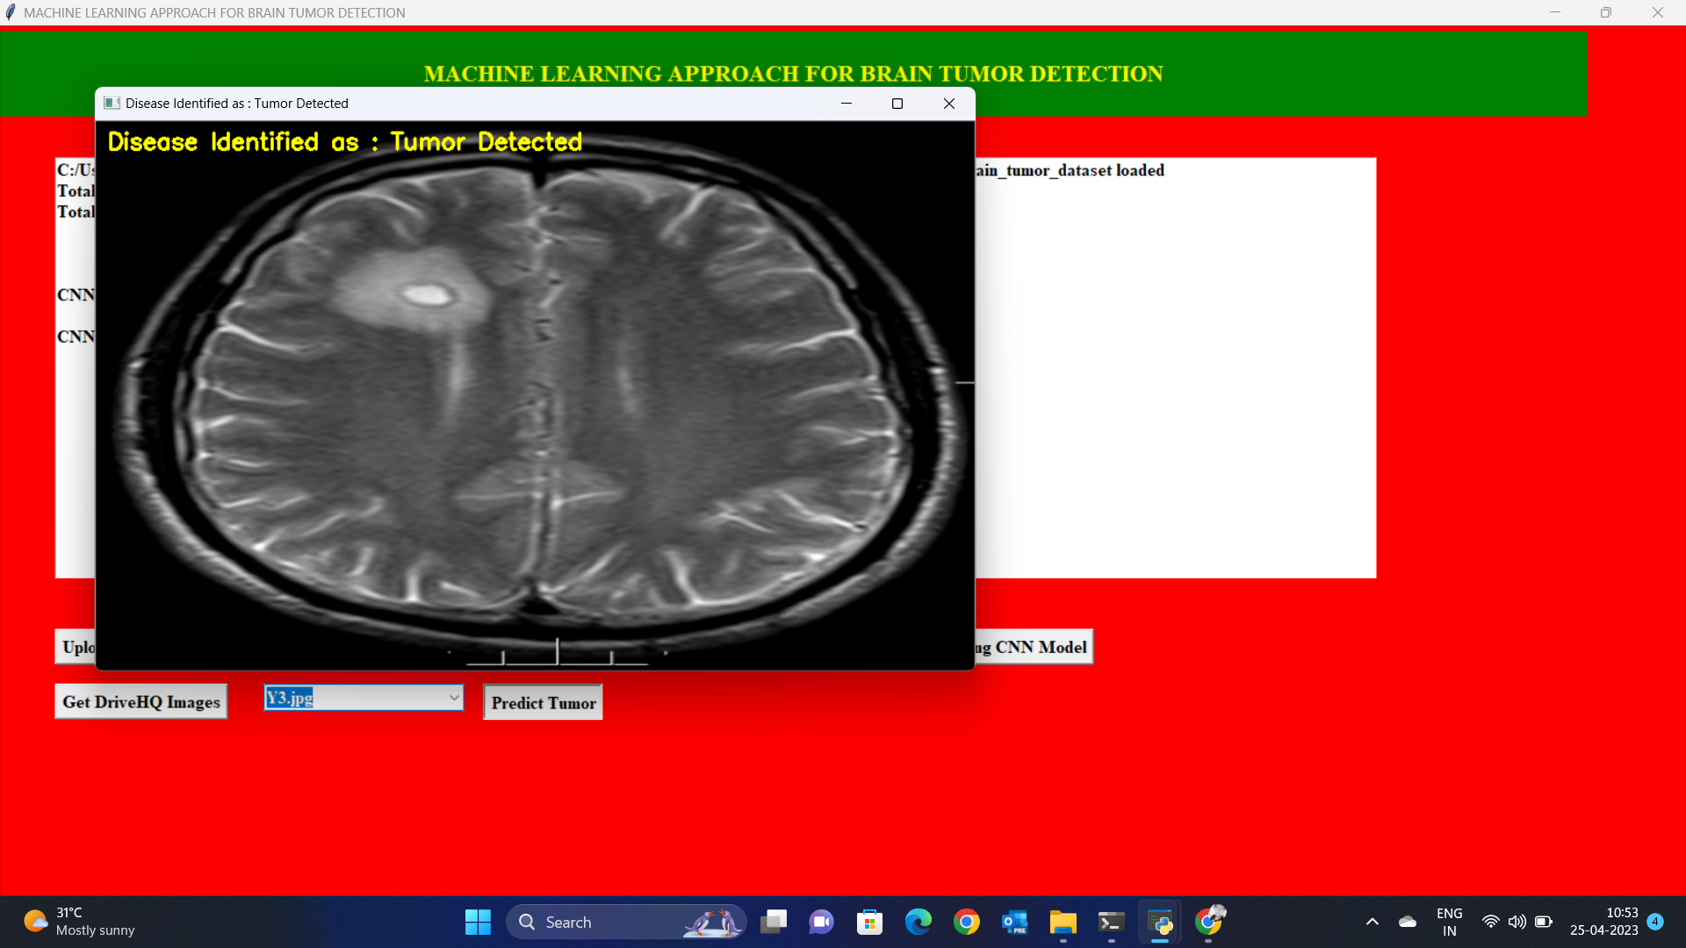
Predict
ABSTRACT

Slide 37

END

Slide 38
CONCLUSION
The time-consuming process of brain tumor detection is thus simplified by automation. An accuracy of 95.55% on testing data is achieved by the proposed model for detecting brain tumor. After detecting the tumor with convolutional neural network.
A much higher accuracy can be achieved by gaining a better dataset with high-resolution images taken directly from the MRI scanner as a input for detection of brain tumor. Moreover, classifier boosting techniques can be used to raise the accuracy even higher and reach a level that will allow this tool to be a significant asset to any medical facility dealing with brain tumors.
ABSTRACT

Slide 39


ABSTRACT
THANK YOU

Slide 40
THANK YOU
FROM_M.V.Chandra Sekhar Reddy
ABSTRACT

